Slide 1
REST API Workshop
Use the Blackboard Developer Platform to Build Your First REST Application

Slide 2
Scott Hurrey Senior Technical Writer Mark O’Neil Senior Product Manager Mark Kauffman Partner Software Engineer developers@blackboard.com

Slide 3
Prerequisites
It is assumed that the attendee has:
User has installed and started the latest Developer Virtual Machine.
User has installed and configured GIT.
User has cloned the repository to their local working directory.
User has Java 8 installed and configured to JAVA_HOME.
User has registered for an account on the Developer Portal.
This code has:
Been built on Mac and in Eclipse (STS)
Not been tested on Windows, though it should work

Slide 4
If Not, It’s OK!!
You can still follow along!
https://github.com/blackboard/BBDN-DevCon-REST-Workshop

Slide 5
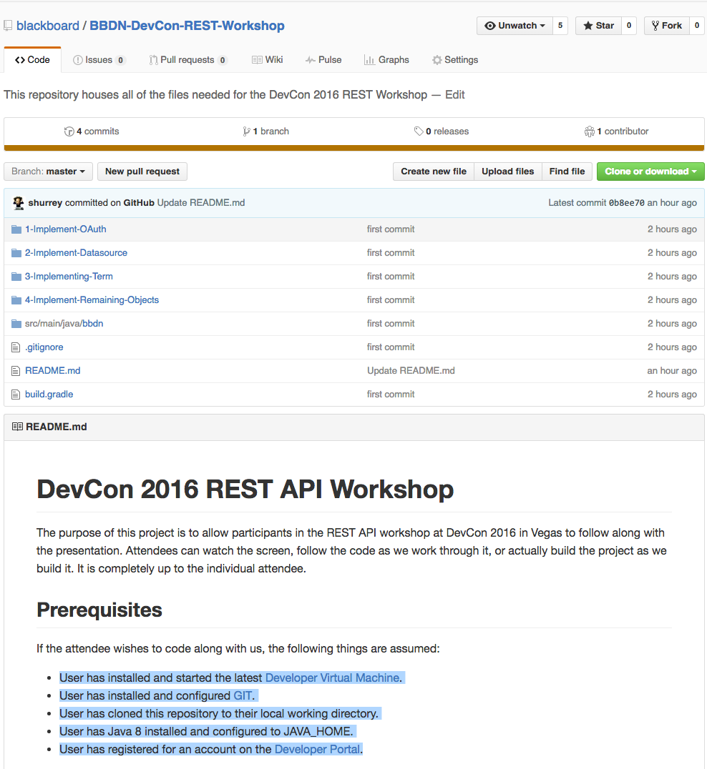
About This Project
Command line Java application
Uses Spring RestTemplate
Uses Jackson to serialize/deserialize objects
Built with Gradle, Application Plugin
Offers a command line flag to disable Cert checking
After DevCon, powerpoint will be added to project
A document walking through this workshop will be available on the community site.

Slide 6
SDLC -> REST
Interested Developer
Review Portal for APIs
Developer Registers
Account/Application
The developer portal allows a Developer to view API documentation and register as a Developer and an Application for FREE!
Developer Designs and Creates
REST Application to Integrate with Blackboard
System Administrator
Adds Application ID
REST Application
Works!!

Slide 7
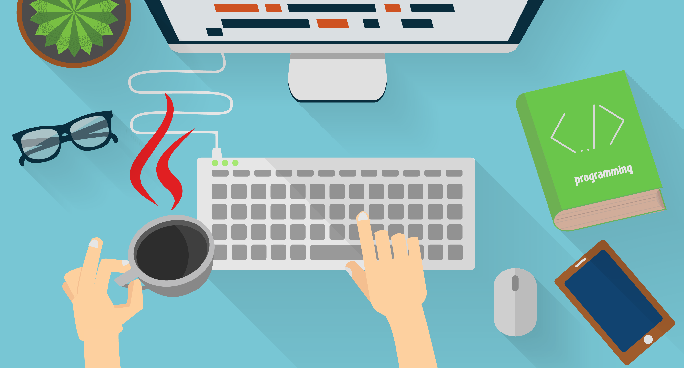
Let’s Code!!

Slide 8
Additional Resourses
REST Developer Community
http://bit.ly/BlackboardRESTDev

